Slide 1

Introduction to Probability and Statistics
Twelfth Edition
Robert J. Beaver • Barbara M. Beaver • William Mendenhall
Presentation designed and written by:
Barbara M. Beaver

Slide 2
Introduction to Probability and Statistics
Twelfth Edition
Chapter 9
Large-Sample Tests of Hypotheses
Some graphic screen captures from Seeing Statistics ®
Some images © 2001-(current year) www.arttoday.com

Slide 3

Introduction
Suppose that a pharmaceutical company
is concerned that the mean potency μ of an antibiotic meet the minimum government potency standards. They need to decide between two possibilities:
  The mean potency μ does not exceed the mean allowable potency.
  The mean potency μ exceeds the mean allowable potency.
This is an example of a test of hypothesis.

Slide 4

Introduction
Similar to a courtroom trial. In trying a person for a crime, the jury needs to decide between one of two possibilities:
  The person is guilty.
  The person is innocent.
To begin with, the person is assumed innocent.
The prosecutor presents evidence, trying to convince the jury to reject the original assumption of innocence, and conclude that the person is guilty.

Slide 5
Parts of a Statistical Test
The null hypothesis, H₀:
  Assumed to be true until we can prove otherwise.
The alternative hypothesis, H_{a}:
  Will be accepted as true if we can disprove H₀
Court trial: Pharmaceuticals:
H₀: innocent H₀: μ does not exceeds allowed amount
H_{a}: guilty H_{a}: μ exceeds allowed amount

Slide 6
Parts of a Statistical Test
The test statistic and its p-value:
A single statistic calculated from the sample which will allow us to reject or not reject H₀, and
A probability, calculated from the test statistic that measures whether the test statistic is likely or unlikely, assuming H₀ is true.
The rejection region:
  A rule that tells us for which values of the test statistic, or for which p-values, the null hypothesis should be rejected.

Slide 7
Parts of a Statistical Test
Conclusion:
  Either “Reject H₀” or “Do not reject H₀”, along with a statement about the reliability of your conclusion.
How do you decide when to reject H₀?
  Depends on the significance level, α, the maximum tolerable risk you want to have of making a mistake, if you decide to reject H₀.
  Usually, the significance level is α = .01 or α = .05.

Slide 8

Example
The mayor of a small city claims that the average income in his city is $35,000 with a standard deviation of $5000. We take a sample of 64 families, and find that their average income is $30,000. Is his claim correct?
1-2. We want to test the hypothesis:
H₀: μ = 35,000 (mayor is correct) versus
H_{a}: μ ≠ 35,000 (mayor is wrong)
Start by assuming that H₀ is true and μ = 35,000.

Slide 9
Example
The best estimate of the population mean μ is the sample mean, $30,000:
  From the Central Limit Theorem the sample mean has an approximate normal distribution with mean μ = 35,000 and standard error SE = 5000/8 = 625.
  The sample mean, $30,000 lies z = (30,000 – 35,000)/625 = -8 standard deviations below the mean.
  The probability of observing a sample mean this far from μ = 35,000 (assuming H₀ is true) is nearly zero.

Slide 10
Example
From the Empirical Rule, values more than three standard deviations away from the mean are considered extremely unlikely. Such a value would be extremely unlikely to occur if indeed H₀ is true, and would give reason to reject H₀.
Since the observed sample mean, $30,000 is so unlikely, we choose to reject H₀: μ = 35,000 and conclude that the mayor’s claim is incorrect.
The probability that μ = 35,000 and that we have observed such a small sample mean just by chance is nearly zero.

Slide 11
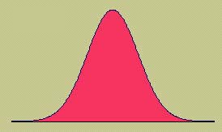
Large Sample Test of a Population Mean, μ
Take a random sample of size n ≥30 from a population with mean μ and standard deviation σ.
We assume that either
  σ is known or
  s ≈ σ since n is large
The hypothesis to be tested is
  H₀:μ = μ₀ versus H_{a}: μ ≠ μ₀

Slide 12

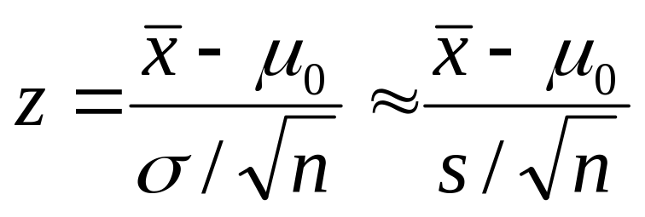
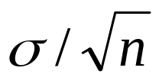
Test Statistic
Assume to begin with that H₀ is true. The sample mean is our best estimate of μ, and we use it in a standardized form as the test statistic:
since has an approximate normal distribution with mean μ₀ and standard deviation .

Slide 13
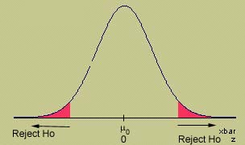
Test Statistic
If H₀ is true the value of should be close to μ₀, and z will be close to 0. If H₀ is false, will be much larger or smaller than μ₀, and z will be much larger or smaller than 0, indicating that we should reject H₀.

Slide 14
Likely or Unlikely?
Once you’ve calculated the observed value of the test statistic, calculate its p-value:
p-value: The probability of observing, just by chance, a test statistic as extreme or even more extreme than what we’ve actually observed. If H₀ is rejected this is the actual probability that we have made an incorrect decision.
If this probability is very small, less than some preassigned significance level, α, H₀ can be rejected.

Slide 15

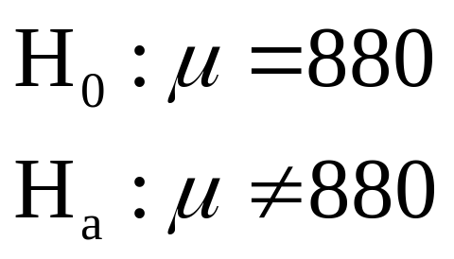
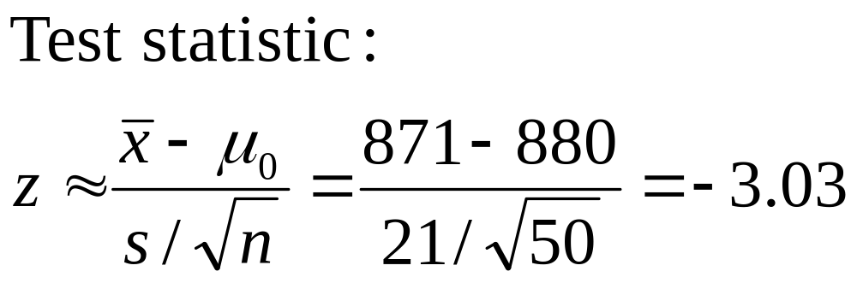
Example
MY
APPLET
The daily yield for a chemical plant
has averaged 880 tons for several years.
The quality control manager wants to know if this average has changed. She randomly selects 50 days and records an average yield of 871 tons with a standard deviation of 21 tons.

Slide 16
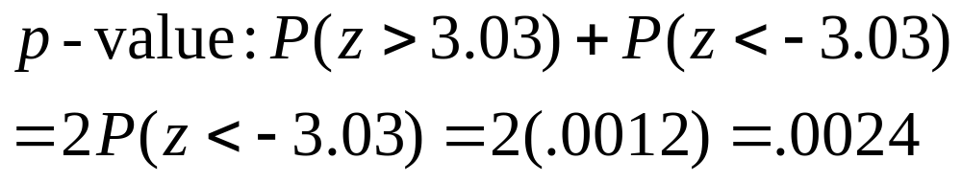
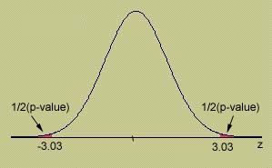
Example
MY
APPLET
What is the probability that this test
statistic or something even more extreme (far from what is expected if H₀ is true) could have happened just by chance?
This is an unlikely occurrence, which happens about 2 times in 1000, assuming μ = 880!

Slide 17
Example
To make our decision clear, we choose
a significance level, say α = .01.
If the p-value is less than α, H₀ is rejected as false. You report that the results are statistically significant at level α.
If the p-value is greater than α, H₀ is not rejected. You report that the results are not significant at level α.
Since our p-value =.0024 is less than, we reject H₀ and conclude that the average yield has changed.

Slide 18
Using a Rejection Region
If α = .01, what would be the critical
value that marks the “dividing line” between “not rejecting” and “rejecting” H₀?
If p-value < α, H₀ is rejected.
If p-value > α, H₀ is not rejected.
The dividing line occurs when p-value = α. This is called the critical value of the test statistic.
Test statistic > critical value implies p-value < α, H₀ is rejected.
Test statistic < critical value implies p-value > α, H₀ is not rejected.

Slide 19
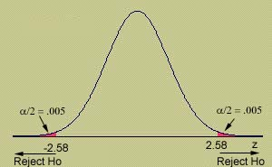
Example
MY
APPLET
What is the critical value of z that
cuts off exactly α/2 = .01/2 = .005 in the tail of the z distribution?
For our example, z = -3.03 falls in the rejection region and H₀ is rejected at the 1% significance level.
Rejection Region: Reject H₀ if z > 2.58 or z < -2.58. If the test statistic falls in the rejection region, its p-value will be less than α = .01.

Slide 20
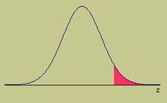
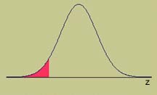
One Tailed Tests
Sometimes we are interested in a detecting a specific directional difference in the value of μ.
The alternative hypothesis to be tested is one tailed:
  H_{a}:μ > μ₀ or H_{a}: μ < μ₀
Rejection regions and p-values are calculated using only one tail of the sampling distribution.

Slide 21

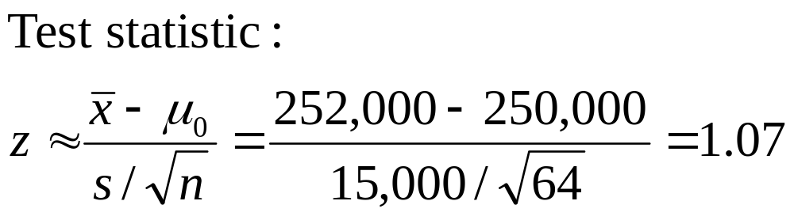
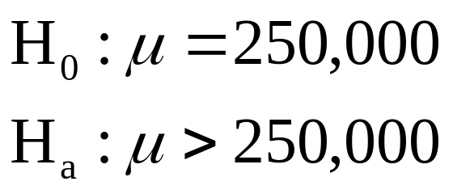
Example
MY
APPLET
A homeowner randomly samples 64 homes similar to her own and finds that the average selling price is $252,000 with a standard deviation of $15,000. Is this sufficient evidence to conclude that the average selling price is greater than $250,000? Use α = .01.

Slide 22
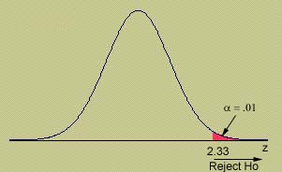
Critical Value Approach
What is the critical value of z that
cuts off exactly α= .01 in the right-tail of the z distribution?
For our example, z = 1.07 does not fall in the rejection region and H₀ is not rejected. There is not enough evidence to indicate that μ is greater than $250,000.
MY
APPLET
Rejection Region: Reject H₀ if z > 2.33. If the test statistic falls in the rejection region, its p-value will be less than α = .01.

Slide 23
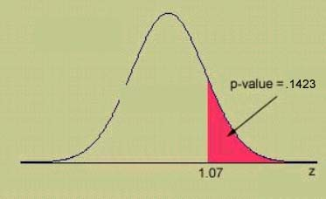
p-Value Approach
The probability that our sample results or something even more unlikely would have occurred just by chance, when μ = 250,000.
Since the p-value is greater than α = .01, H₀ is not rejected. There is insufficient evidence to indicate that μ is greater than $250,000.
MY
APPLET

Slide 24
Statistical Significance
The critical value approach and the p-value approach produce identical results.
The p-value approach is often preferred because
  Computer printouts usually calculate p-values
  You can evaluate the test results at any significance level you choose.
What should you do if you are the experimenter and no one gives you a significance level to use?

Slide 25
Statistical Significance
If the p-value is less than .01, reject H₀. The results are highly significant.
If the p-value is between .01 and .05, reject H₀. The results are statistically significant.
If the p-value is between .05 and .10, do not reject H₀. But, the results are tending towards significance.
If the p-value is greater than .10, do not reject H₀. The results are not statistically significant.

Slide 26
Two Types of Errors
There are two types of errors which can
occur in a statistical test.
Actual Fact Jury’s Decision | Guilty | Innocent
Guilty | Correct | Error
Innocent | Error | Correct
Actual Fact Your Decision | H₀ true (Accept H₀) | H₀ false (Reject H₀)
H₀ true (Accept H₀) | Correct | Type II Error
H₀ false (Reject H₀) | Type I Error | Correct
Define:
α = P(Type I error) = P(reject H₀ when H₀ is true)
β =P(Type II error) = P(accept H₀ when H₀ is false)

Slide 27
Two Types of Errors
We want to keep the probabilities of
error as small as possible.
The value of α is the significance level, and is controlled by the experimenter.
The value of β is difficult, if not impossible to calculate.
Rather than “accepting H₀” as true without being able to provide a measure of goodness, we choose to “not reject” H₀.
We write: There is insufficient evidence to reject H₀.

Slide 28
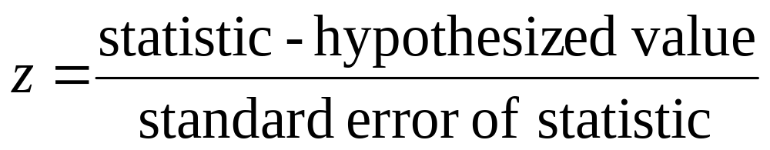
Other Large Sample Tests
There were three other statistics in Chapter 8 that we used to estimate population parameters.
These statistics had approximately normal distributions when the sample size(s) was large.
These same statistics can be used to test hypotheses about those parameters, using the general test statistic:

Slide 29
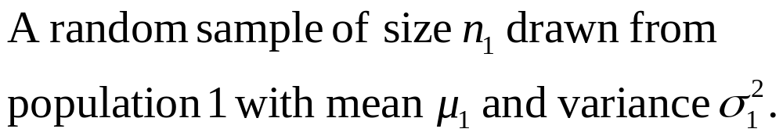
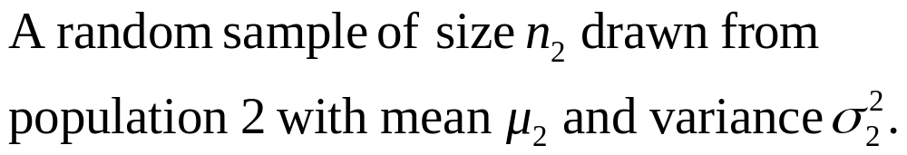
Testing the Difference between Two Means
The hypothesis of interest involves the difference, μ₁−μ₂, in the form:
  H₀: μ₁−μ₂ = D₀ versus H_{a}: one of three
where D₀ is some hypothesized difference, usually 0.

Slide 30
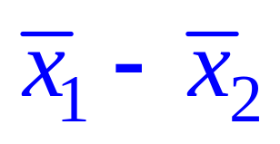
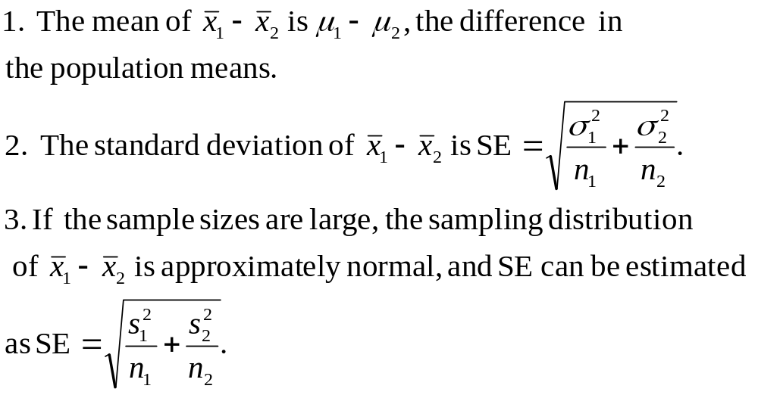
The Sampling Distribution of

Slide 31
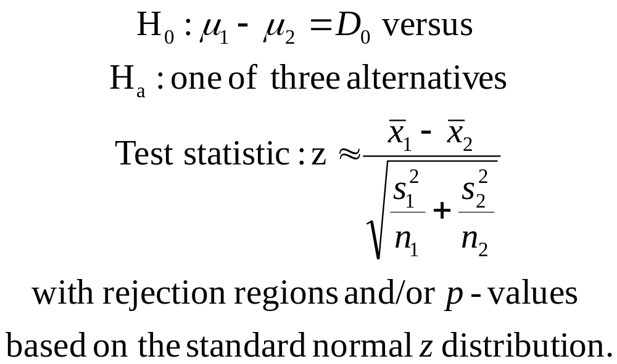
Testing the Difference between Two Means

Slide 32

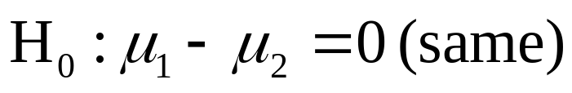
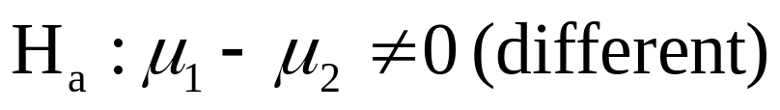
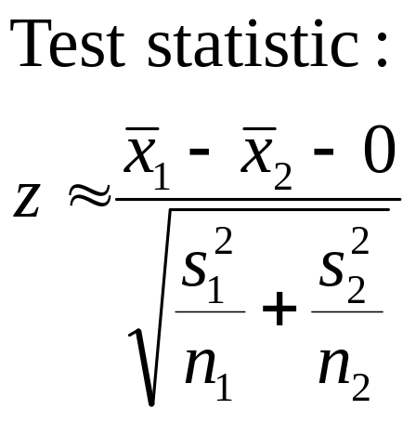
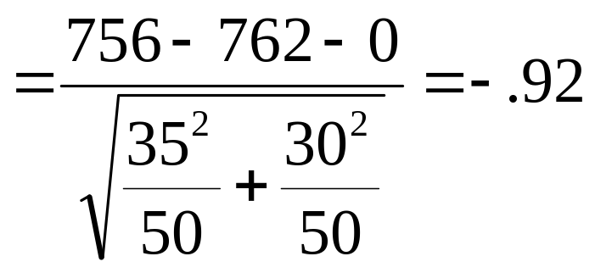
Example
Avg Daily Intakes | Men | Women
Sample size | 50 | 50
Sample mean | 756 | 762
Sample Std Dev | 35 | 30
Is there a difference in the average daily intakes of dairy products for men versus women? Use α = .05.

Slide 33
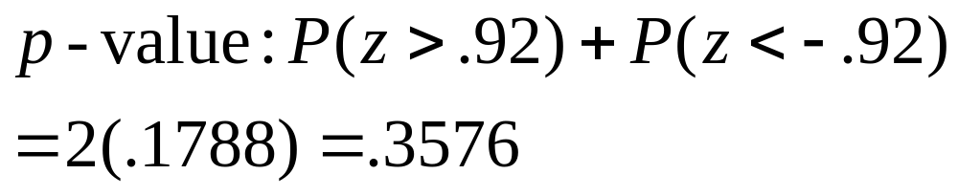
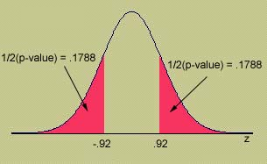
p-Value Approach
The probability of observing values of z that as far away from z = 0 as we have, just by chance, if indeed μ₁−μ₂ = 0.
Since the p-value is greater than α = .05, H₀ is not rejected. There is insufficient evidence to indicate that men and women have different average daily intakes.

Slide 34
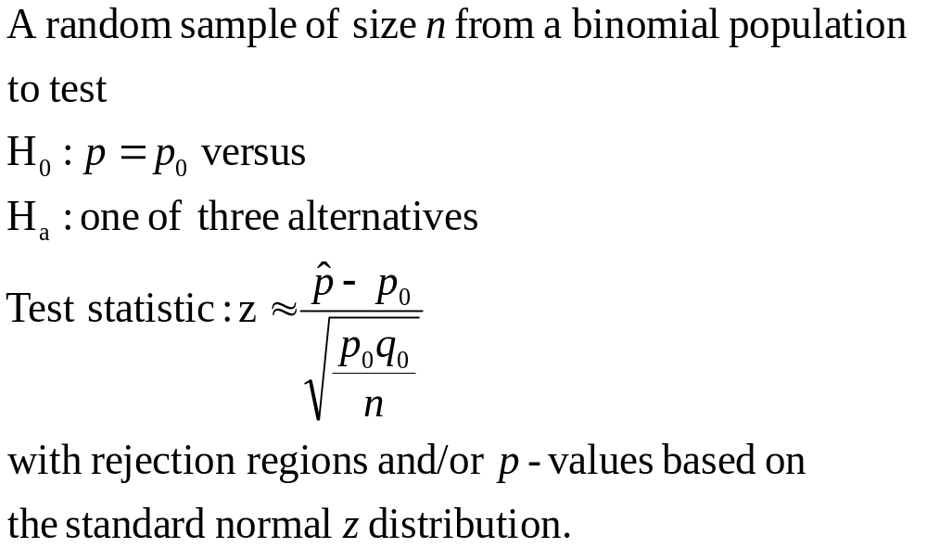
Testing a Binomial Proportion p

Slide 35

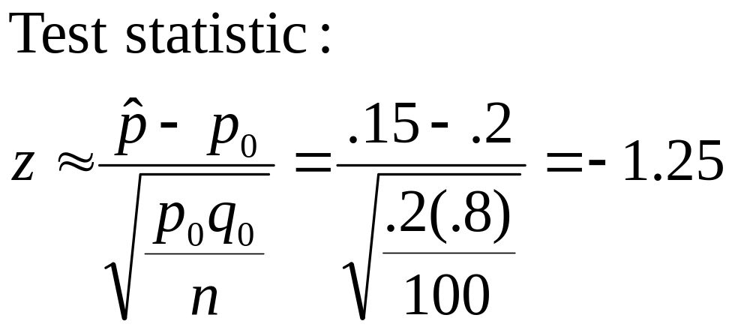
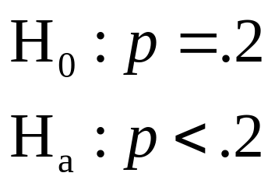
Example
Regardless of age, about 20% of American
adults participate in fitness activities at least twice a week. A random sample of 100 adults over 40 years old found 15 who exercised at least twice a week. Is this evidence of a decline in participation after age 40? Use α = .05.

Slide 36
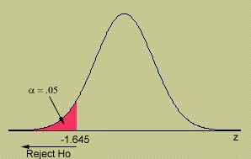
Critical Value Approach
What is the critical value of z that
cuts off exactly α= .05 in the left-tail of
the z distribution?
For our example, z = -1.25 does not fall in the rejection region and H₀ is not rejected. There is not enough evidence to indicate that p is less than .2 for people over 40.
Rejection Region: Reject H₀ if z < -1.645. If the test statistic falls in the rejection region, its p-value will be less than α = .05.

Slide 37
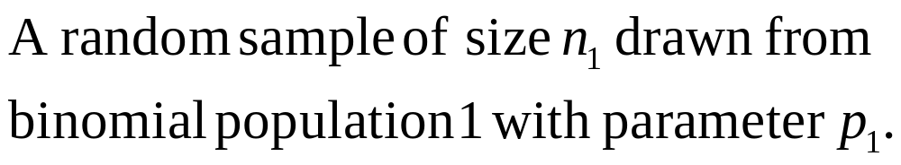
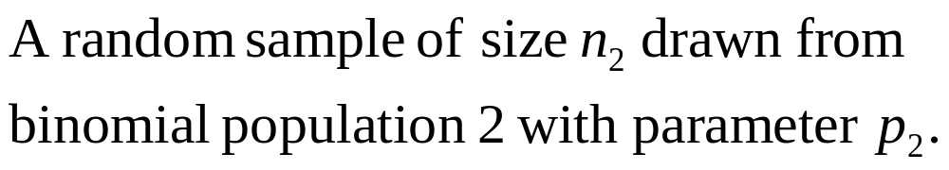
Testing the Difference between Two Proportions
To compare two binomial proportions,
  The hypothesis of interest involves the difference, p₁−p₂, in the form:
  H₀: p₁−p₂ = D₀ versus H_{a}: one of three
  where D₀ is some hypothesized difference, usually 0.

Slide 38
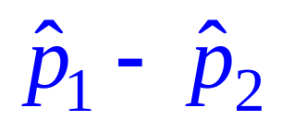
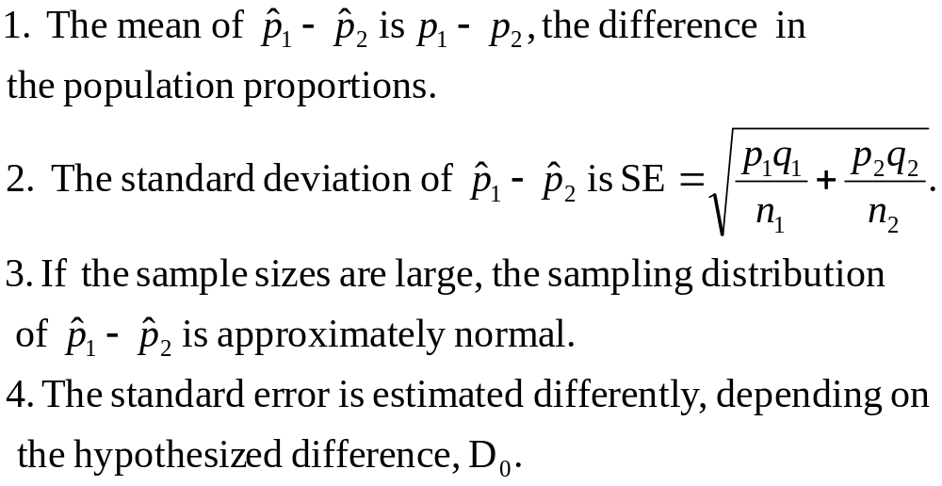
The Sampling Distribution of

Slide 39
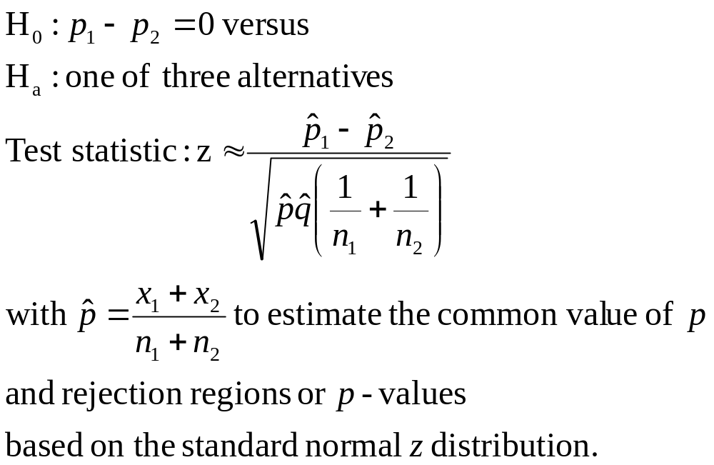
Testing the Difference between Two Proportions

Slide 40

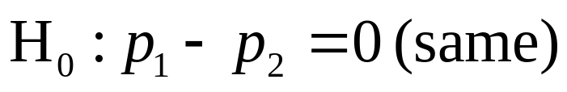
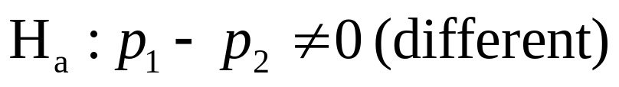
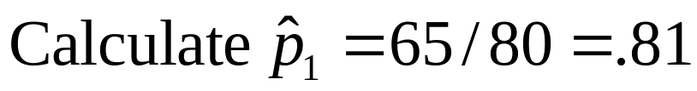
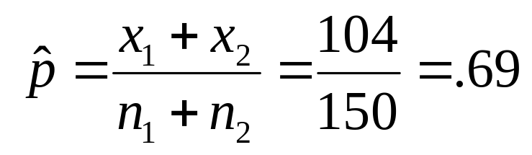
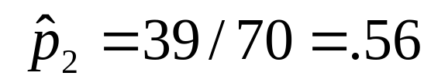
Example
Youth Soccer | Male | Female
Sample size | 80 | 70
Played soccer | 65 | 39
Compare the proportion of male and female college students who said that they had played on a soccer team during their K-12 years using a test of hypothesis.

Slide 41
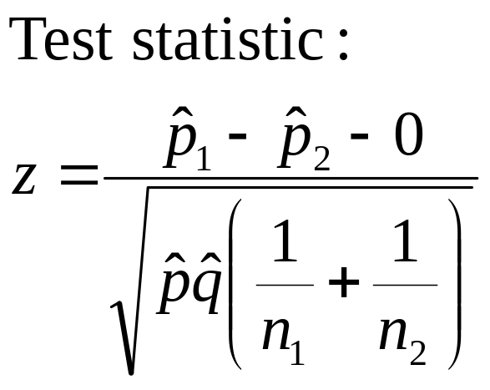
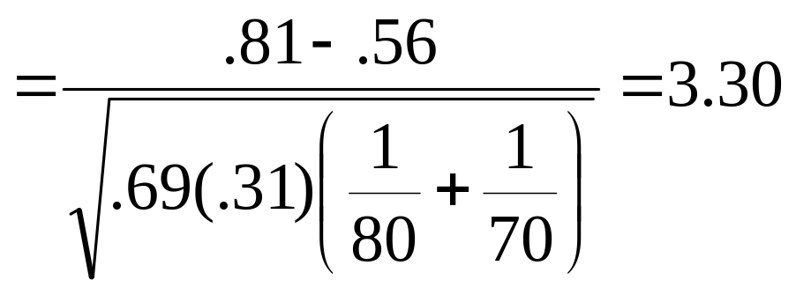
Example
Youth Soccer | Male | Female
Sample size | 80 | 70
Played soccer | 65 | 39
Since the p-value is less than α = .01, H₀ is rejected. The results are highly significant. There is evidence to indicate that the rates of participation are different for boys and girls.

Slide 42
Key Concepts
I. Parts of a Statistical Test
1. Null hypothesis: a contradiction of the alternative hypothesis
2. Alternative hypothesis: the hypothesis the researcher wants to support.
3. Test statistic and its p-value: sample evidence calculated
from sample data.
4. Rejection region—critical values and significance levels: values that separate rejection and nonrejection of the null
hypothesis
5. Conclusion: Reject or do not reject the null hypothesis,
stating the practical significance of your conclusion.

Slide 43
Key Concepts
II. Errors and Statistical Significance
1. The significance level α is the probability if rejecting H ₀
when it is in fact true.
2. The p-value is the probability of observing a test statistic as extreme as or more than the one observed; also, the smallest value of α for which H ₀ can be rejected.
3. When the p-value is less than the significance level α , the
null hypothesis is rejected. This happens when the test
statistic exceeds the critical value.
4. In a Type II error, β is the probability of accepting H ₀ when it is in fact false. The power of the test is (1 − β ), the probability of rejecting H ₀ when it is false.

Slide 44
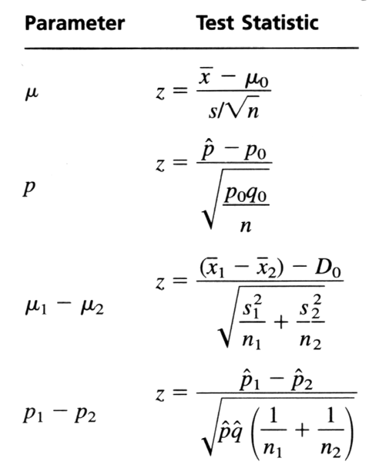
Key Concepts
III. Large-Sample Test Statistics Using the z Distribution
To test one of the four population parameters when the sample sizes are large, use the following test statistics:

